Slide 1



PET RETREAT
One-Stop Pet Care Solution

Slide 2


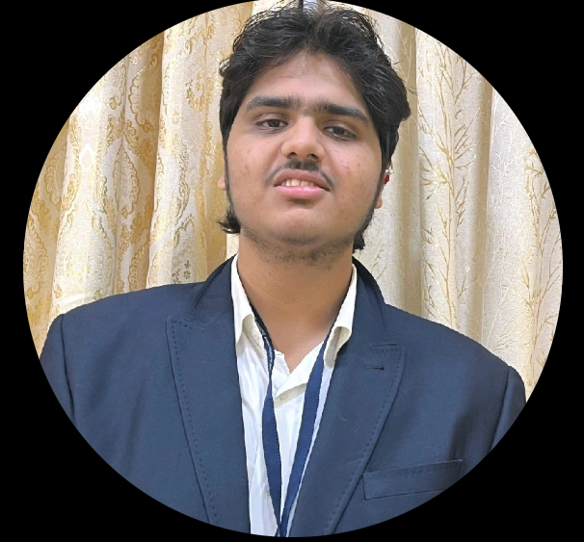
Co-founders
Manas Kulkarni
(CEO)
Strategic Vision
Equity: 25%
Atharva Joshi
(CFO)
Financial Management
Equity: 25%

Slide 3


Co-founders
Atharva Maslekar
(CIO)
Innovative Mindset
Equity: 25%
Atharva Suryawanshi
(COO)
Resolute Decisiveness
Equity: 25%

Slide 4
Problem Statement
01
Pet owners struggle with multiple service providers.
02
03
High demand for convenience but no all-in-one solution.
Very few integrated services.

Slide 5
Our Solution
24/7 Veterinary Care
Grooming & Hygiene Services
Boarding & Daycare
Pet Taxi for Easy Transport
App-Based Booking & Live Monitoring
Pet Training & Retail Store

Slide 6
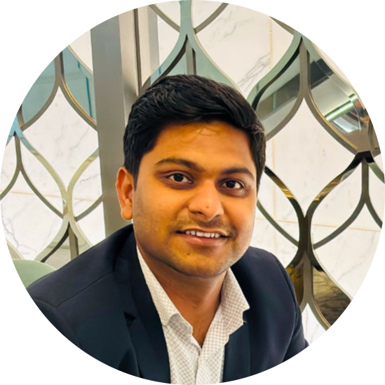


Pitching Details
Pragalbh Thakur
Angel Investor | VC | Business Consultant

Slide 7
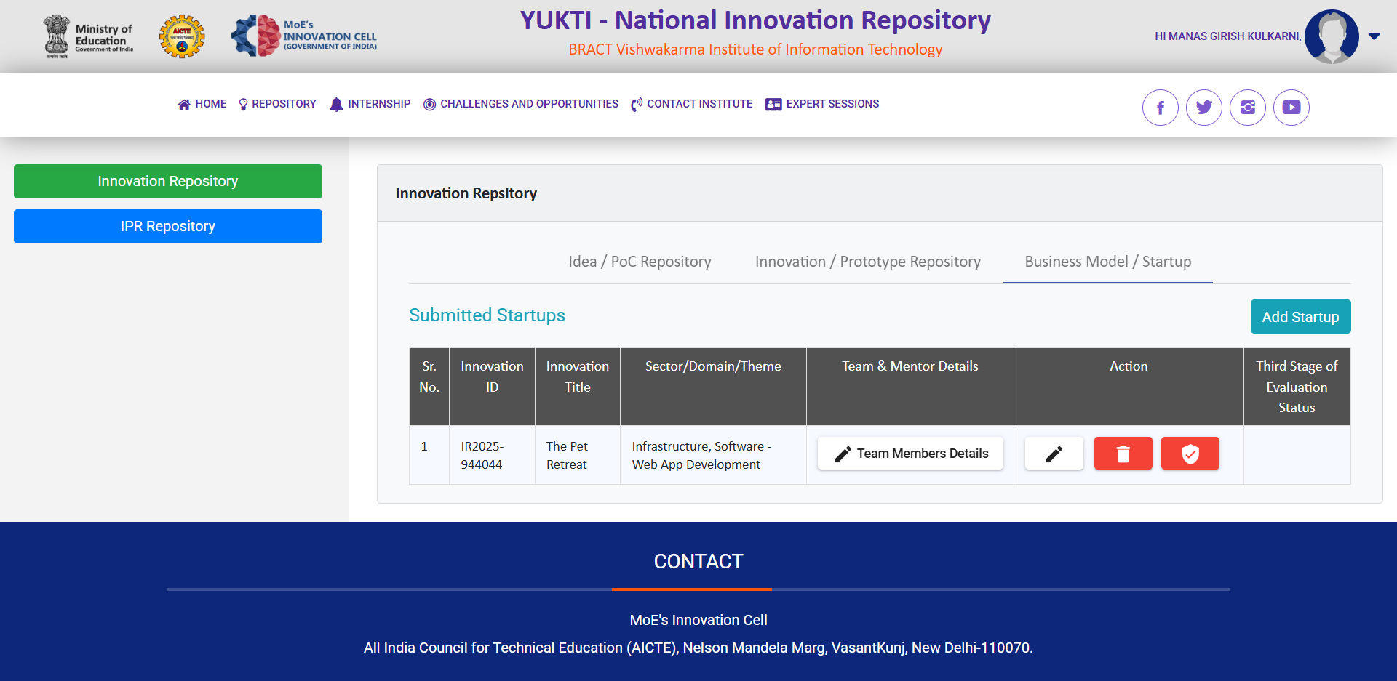
YUKTI

Slide 8
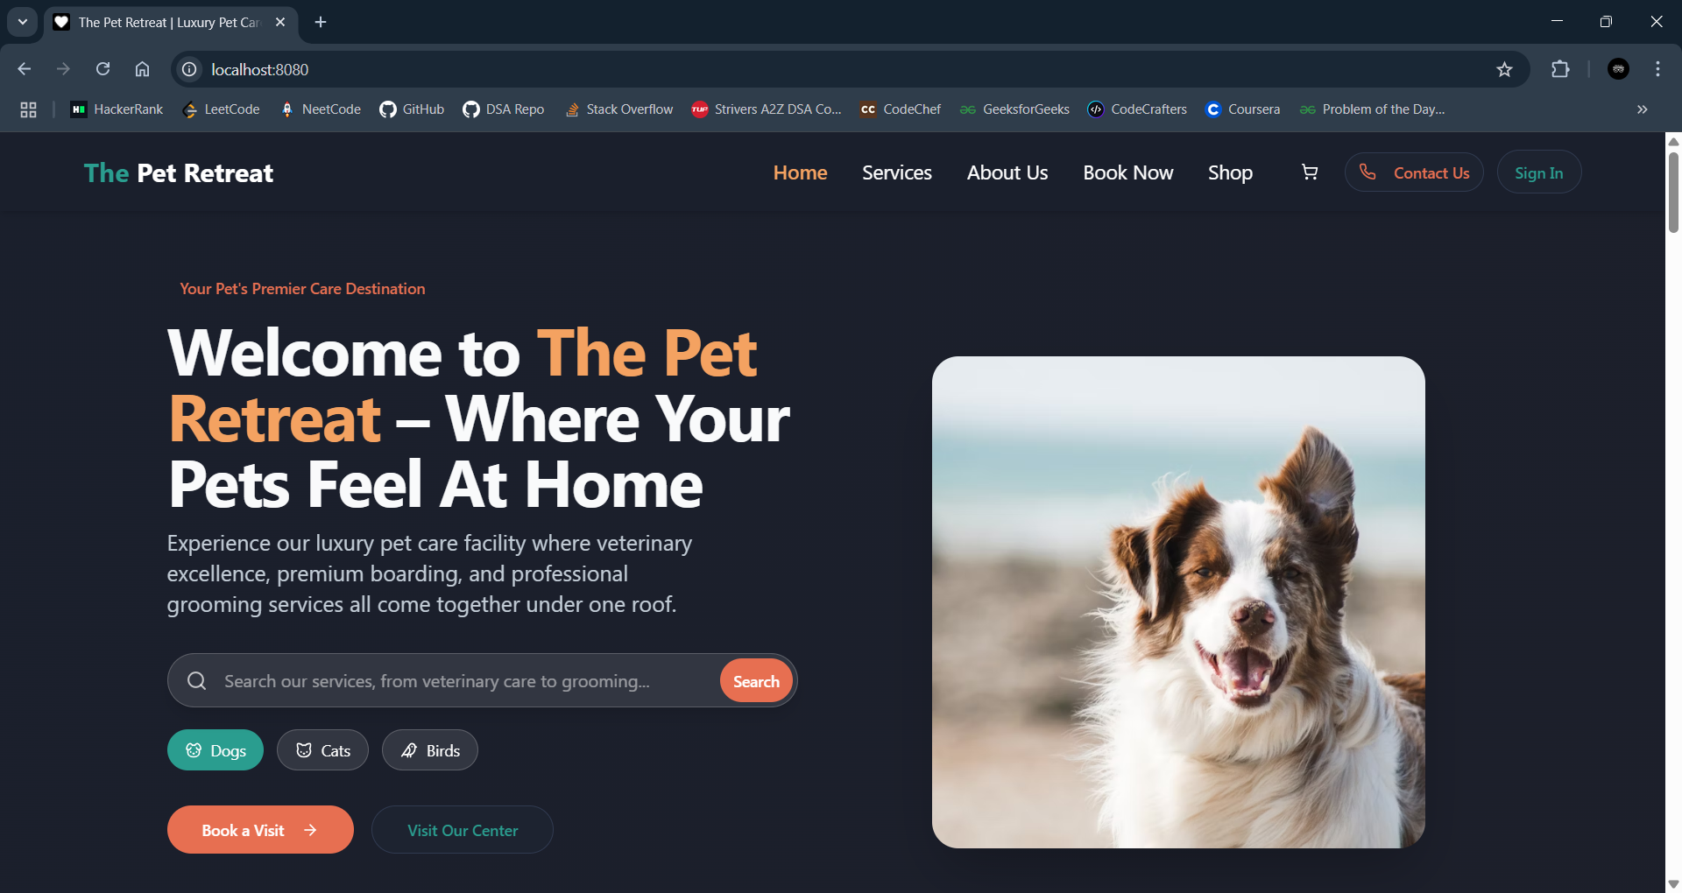
Our Website

Slide 9
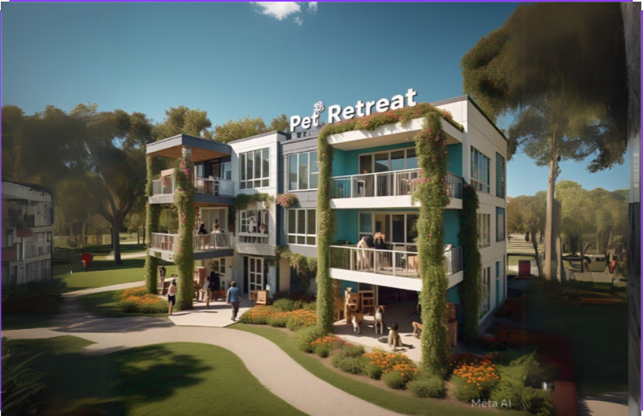
Our Facility
Source: Meta AI
AI Generated image.
For illustrative purposes only.

Slide 10
Market Opportunity
Urban pet ownership is rising, increasing demand for premium services.
Target Customers: Pet Owners
$3.5 Billion
Total Available Market in India
Growing at 19%
CAGR

Slide 11
Competitive Landscape
Competitors | Services | Weaknesses
Standalone Clinics | Vet Care | No Grooming, Boarding
Pet Hostels | Boarding Only | No Medical Support
Aggregators (e.g. FurCrew) | Service Listings | No Pet Taxi, Poor UX
💡 The Pet Retreat = All-in-One Convenience + 24/7 Care + Real-Time Tracking

Slide 12


01
02
03
Short
Term
Mid
Term
Long
Term
Successful pilot in Pune
With 3-4 core services
Expand to Tier 1 cities
Establish as India’s leading integrated pet care service
Our Vision
Page 11

Slide 13
01
Short Term (0-1 yr)
Revenue: ₹12-20 lakh
Unit Economics:
🔹 Veterinary Services: ₹3-4L (5-10 consultations/day @ ₹500-1100) 🔹 Boarding & Daycare: ₹2-3L (8-12 pets/day @ ₹500/night) 🔹 Grooming & Hygiene: ₹1.5-2L (11-13 pets/day @ ₹500/session) 🔹 Retail Store: ₹1-2L (Basic pet food & accessories) 🔹 Pet Taxi: ₹0.5-1L (5-10 trips/day @ ₹300 avg/trip)
Page 11
Financial Projections

Slide 14
01
Short Term (0-1 yr)
CAPEX : ₹25-30 lakh
🔹 Facility Setup & Rent: ₹5-7L 🔹 Equipment & Medical Supplies: ₹7-10L
OPEX: 4-6 lakh/month
🔹 Salaries: ₹2-3L (3-5 employees @ ₹15-25k/month) 🔹 Marketing & Branding: ₹50k-1L (Ads, partnerships) 🔹 Miscellaneous: ₹1-2L (Utilities, insurance, admin, fuel)
Net Loss: (₹10 to ₹20 lakh) (Expected loss due to high setup costs; focus on customer acquisition.)
Page 11
Financial Projections

Slide 15
02
Long Term (3+ yrs)
💰 Revenue: ₹35+ Lakhs/Year (Loyal customer base, possible second branch)
🔹 Veterinary Services: ₹5-7L (Steady demand, trusted brand) 🔹 Boarding & Daycare: ₹4-5L (Higher capacity, premium services) 🔹 Grooming & Hygiene: ₹2-3L (20+ pets daily, premium grooming) 🔹 Retail Store: ₹10-15L (Expansion, online sales, exclusive products) 🔹 Online Services & Memberships: ₹5-10L (Subscriptions, telehealth, consultations)
🔹 Pet Taxi Services: ₹3-5L (30-50 trips/day @ ₹300 avg per trip)
💸 Expenses: ₹28L - ₹30 Lakhs/Year (Expansion, hiring, franchising) 📈 Net Profit: ₹5-7L/Year (Scalable model, strong brand recognition, potential franchising)
Page 11
Financial Projections

Slide 16
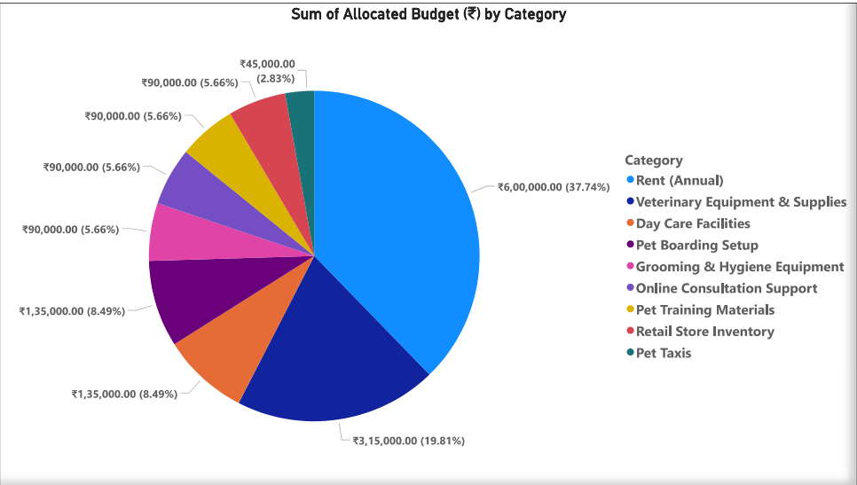
Page 11
Expenses Chart

Slide 17

Why Us?
Passionate about solving real problems in pet care.
Diverse skill set: Operations, Tech, Marketing.
Committed to building a sustainable, customer-focused solution.
Page 01

Slide 18

CONCLUSION
Pet Retreat – A One-Stop Pet Care Solution
Validated Market Demand – Survey proves strong need
Scalable Business Model – Subscription + Pay-per-service
High-Growth Potential – ₹7,500 Cr industry, 19% CAGR
High Cross Selling Opportunity
💡 We’re building the future of pet care. Your insights can help us shape it!

Slide 19

Our Ask
Seeking: ₹10-15 lakh (Pre-Seed Round)
Use of Funds: 🔹 Facility Setup & Equipment – 19.81% 🔹 Salaries & Operations – 8.49% 🔹 Marketing & Branding – 5.66% 🔹 Pet Taxi & Tech Development – 2.83%
🔹 Rent – 37.73%
Funding Plan & Growth
💰 Current Investors: None (Open to co-investors) ⏳ Runway: 12-18 months 🎯 Goal: 3,000+ customers, ₹75 lakh+ revenue
Proposed Valuation
💵 Valuation Sought: ₹35 - 40 L (Pre-Money) 📈 Equity Offered: 20-25%

Slide 20
Exit Options
🔹 Strategic Acquisition – Buyout by pet care brands. 🔹 Franchise Buyout – Investors exit via growing franchise partners. 🔹 Private Equity / VC Exit – Later-stage PE/VC firms acquire early investors. 🔹 IPO (5+ Years) – If scaled across multiple cities.
📌 Comparable Exits: ✅ Heads Up For Tails – ₹200 Cr+ funding, potential IPO. ✅ Supertails & Just Dogs – VC-backed, scaling via franchising.
💰 Expected ROI: 5-10x in 5-7 years via M&A or strategic buyout.

Slide 21
POC

Slide 22
POC

Slide 23

QNA
We’d love to hear your insights & feedback!
Thank you for your time!

